Slide 1

Spring 2025
Watt-A-Coog
Green Hydrogen Plant in Texas
Sai Kiran Anugam Neha Nami Reddy Amogh Varsh Raju Ambati Rohith Pulluri Keerthana Bathini Soubarno Sen

Slide 2
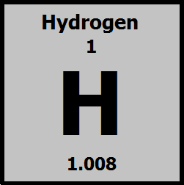
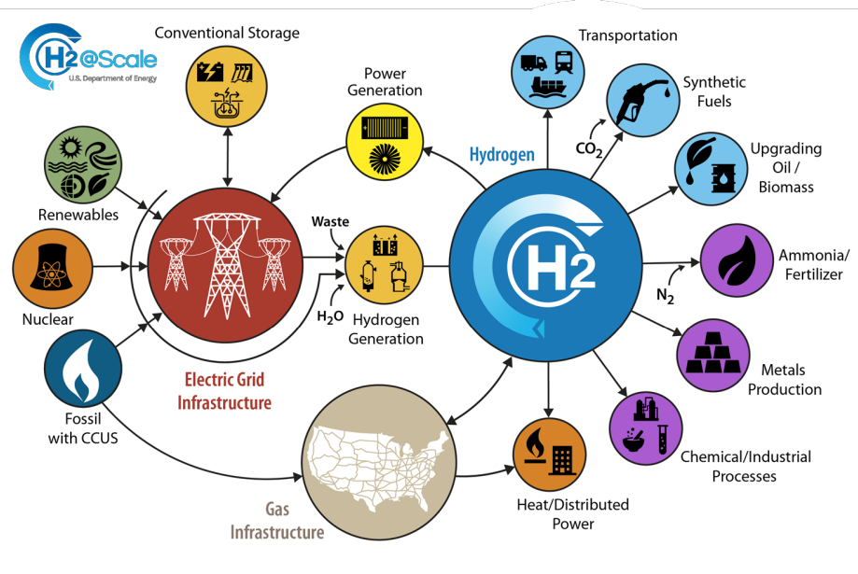
Introduction
Hydrogen is the most abundant element in the universe and a versatile energy carrier.
Fuel with zero carbon emissions when utilized in fuel cells.
Widely used in industries like refining, ammonia production, and chemical manufacturing.

Slide 3
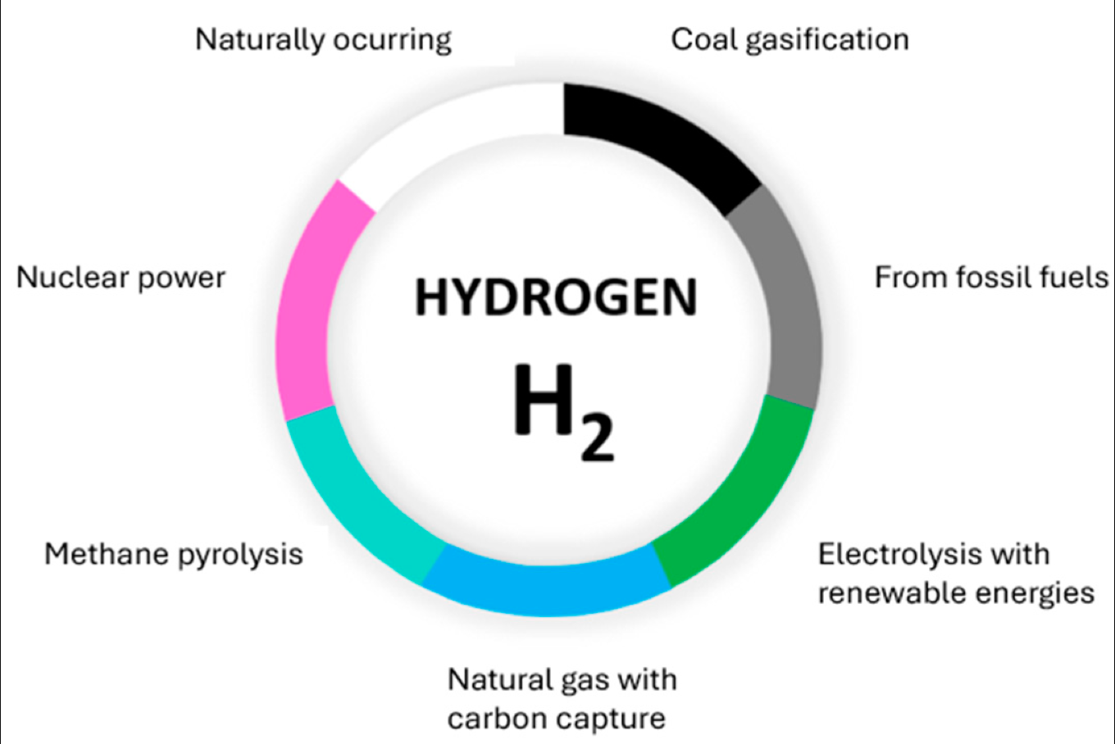
Traditional Approach
Hydrogen has traditionally been produced from fossil fuels through methods like steam methane reforming (SMR) and coal gasification, both of which emit high levels of CO₂.
These carbon-intensive processes have been widely used in industries but contribute significantly to greenhouse gas emissions and climate change.

Slide 4
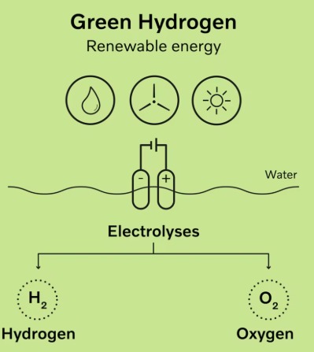
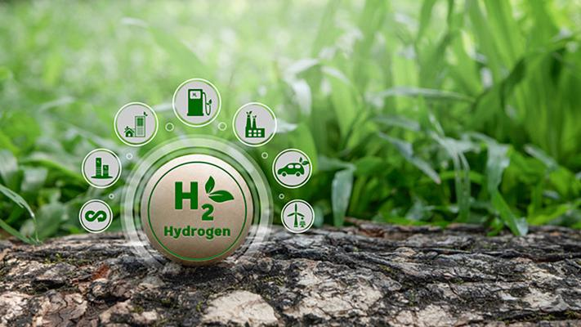
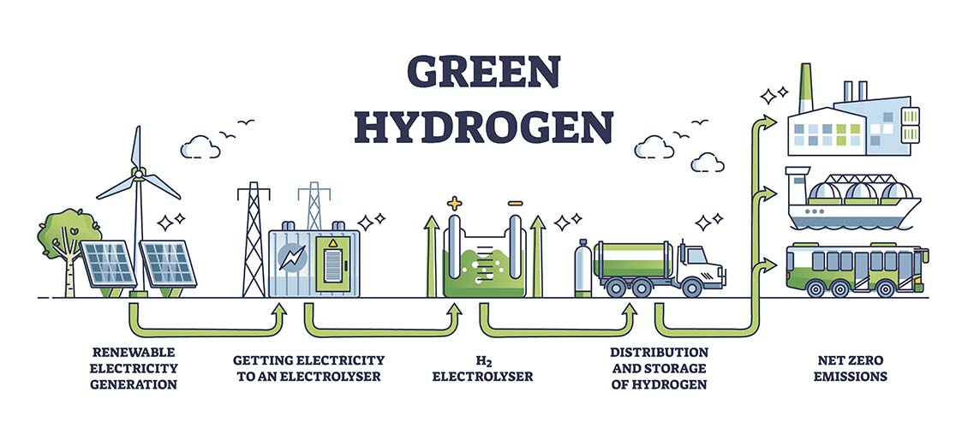
Green Hydrogen
Green hydrogen is hydrogen produced using electrolysis, where electricity from renewable sources splits water into hydrogen and oxygen without emitting carbon.
It is a clean and sustainable alternative to fossil-fuel-based hydrogen.
Plays a crucial role in decarbonizing industries, including transportation, steel production, and energy storage.

Slide 5
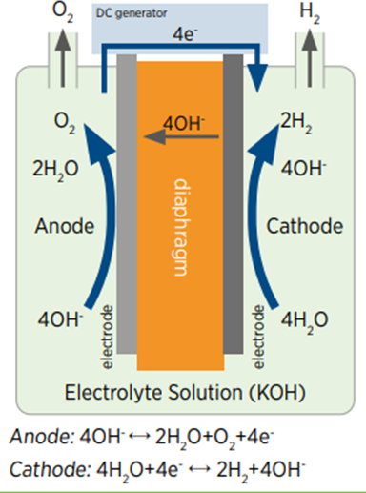
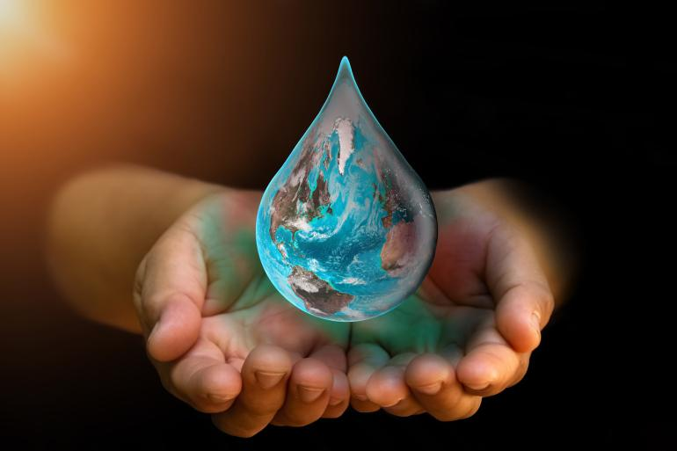
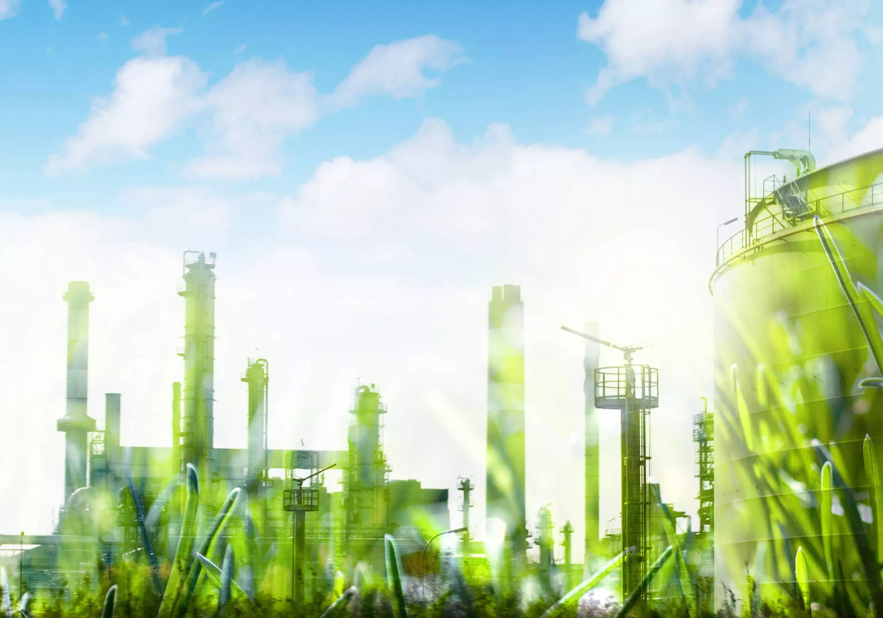
The Problem
Water scarcity concerns
Exploring alternative, efficient electrolysers
Setting up a Green Ammonia Plant

Slide 6
The Problem
S
I
P
O
C
Suppliers
Inputs
Process
Outputs
Customers
Renewable Energy Providers (Solar, Wind)
Industrial gas suppliers
Heat recovery system
Engineering & Automation providers
Electricity
Water
Nitrogen
Waste heat from HB reaction
Hydrogen
Nitrogen
Ammonia gas
Liquid Ammonia
Stored Energy in Chemical form
Chemical Manufacturers
Fertilizer Industry
Energy Storage companies
Hydrogen economy Stakeholders
Electricity powers SOEC for high-temp. electrolysis
Water Splitting into H2 and O2 in SOEC
N2 is purified and mixed with H2 at the optimal ratio
H-B process synthesis of Ammonia at high P,T
Excess heat is recovered and reused in the system
H2 and Ammonia

Slide 7
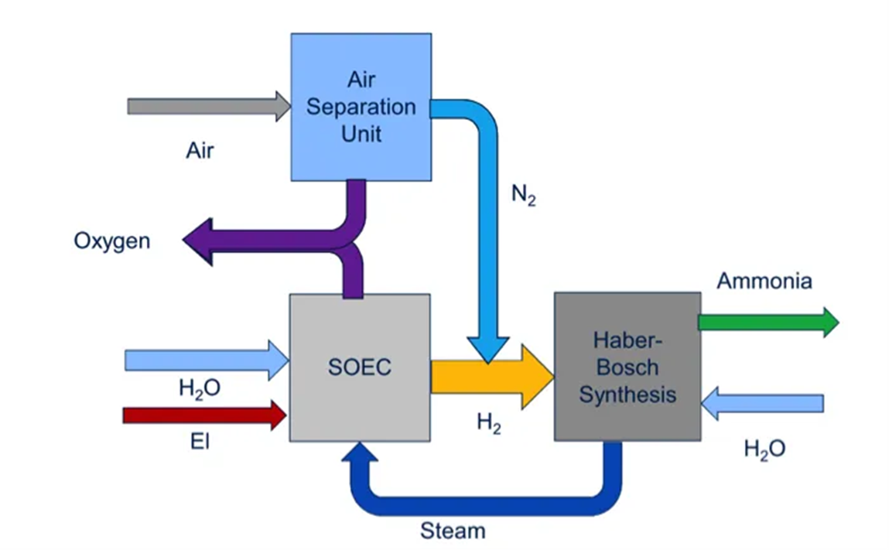
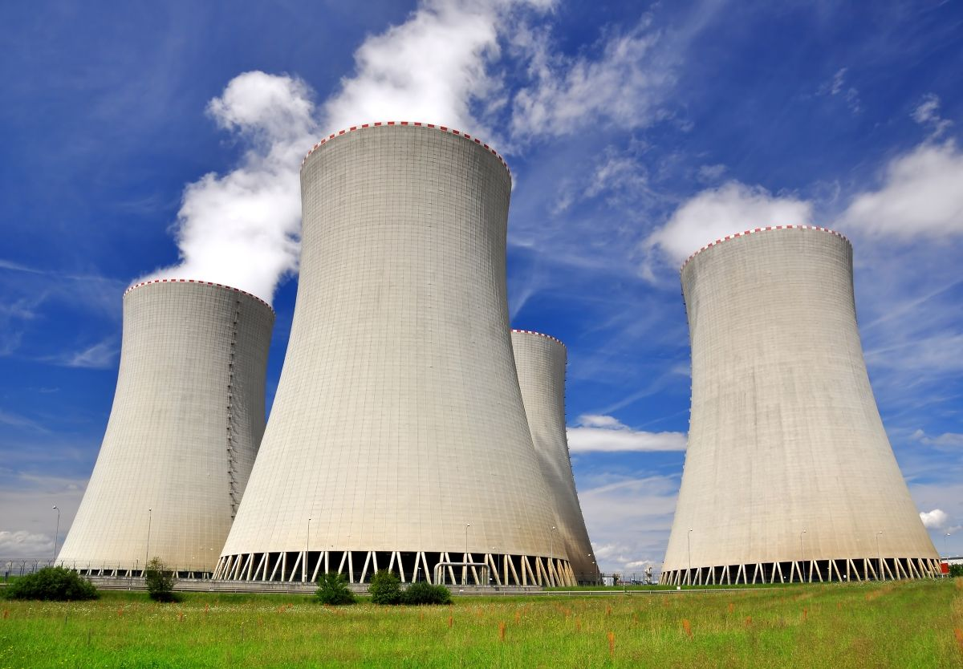
Idea-1: Wastewater Purification and Solid Oxide Electrolysis
Wastewater
Activated Sludge treatment
Clean water
Thermal Desalination
Electricity
Upgraded heat
[Sun] Photovoltaics
Heat Pump
Waste heat

Slide 8
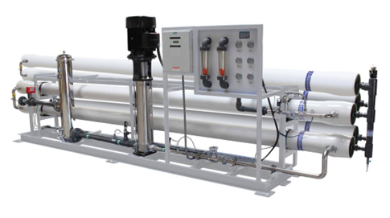
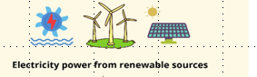
Idea-2: Wastewater Purification and Alkaline Electrolysis
Wastewater
Activated Sludge treatment
Clean Water
Electricity
Ultrafiltration
Perovskite Solar Cells
Hydrogen

Slide 9
Idea-3: Integrating TES with Hydrogen Storage in Metal Hydrides
Oxygen
Nitrogen
[Sun] Photovoltaics
Ammonia synthesis
Through Haber-Bosch Process
Electricity
Solid Oxide Electrolyzer
Hydrogen
Solar
Thermal collectors
Heat recovery
Clean water
Hydrogen Storage in metal Hydrides through absorption
Wastewater
Multi-stage Flash evaporation
Heat desorption during night time
Heat Absorption
Thermal Energy Storage (Phase Change Material)
Continuous flow

Slide 10
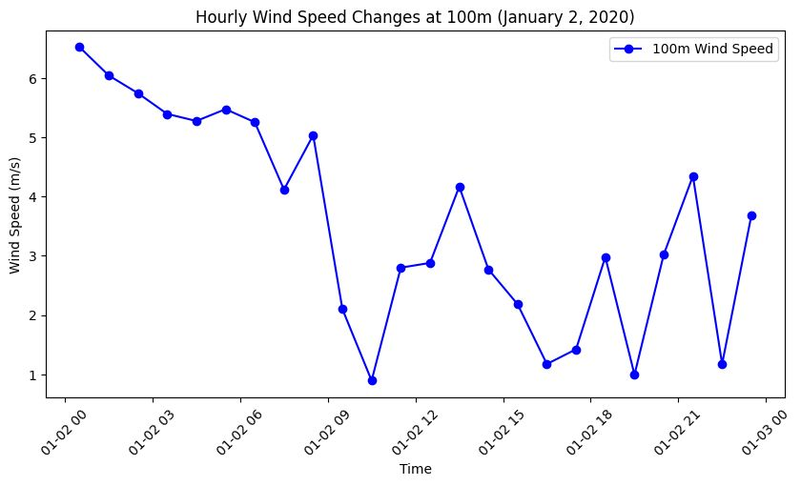
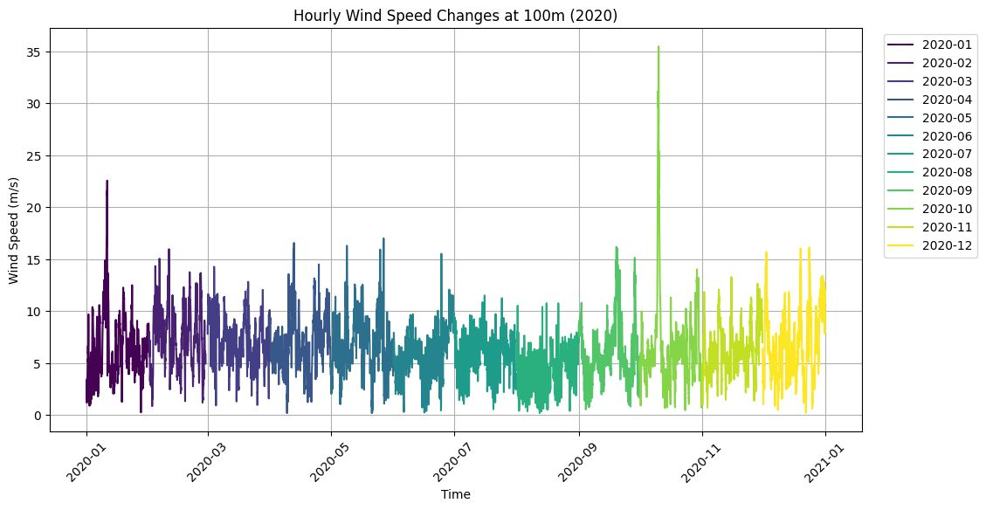
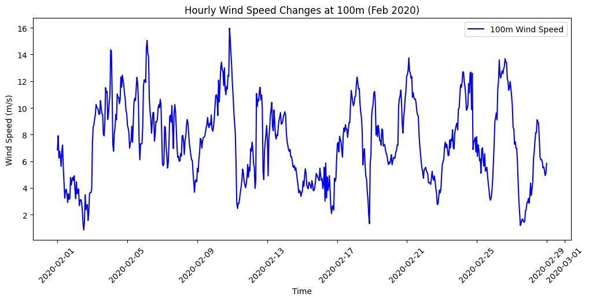
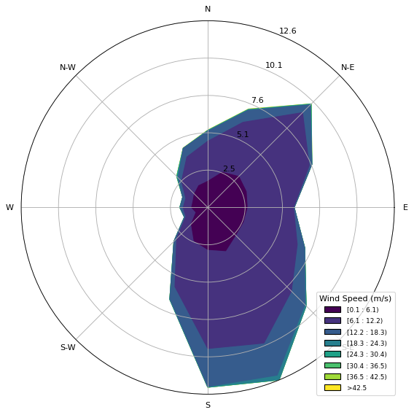
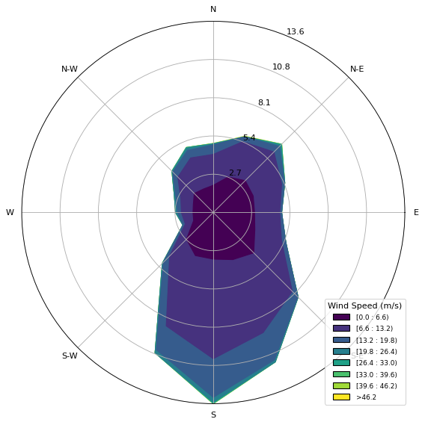
Wind Speed Data Analysis
Analysis of wind speed in a day
Analysis of wind speed in an year
100 m
500 m
Analysis of wind speed in a month
Windrose plots

Slide 12
Slide 1 – Setting the stage (1 min)
What is the problem your idea is attempting to solve? What is the need that your idea is addressing?
What are current solutions? What is the issue / challenge with current solutions that your idea will rectify? How is your idea better than what is currently out there?

Slide 13
Slide 2 – A Deeper Dive into your idea (1 min)
What is your approach to solving the challenge?
Why is your approach advantaged?
How have you validated the advantages of your idea – experiments, testing, Feedback from SME, mentors, etc?

Slide 14
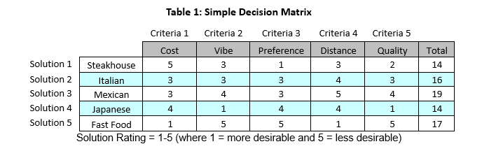
Slide 3 – The Design Decision Matrix (2 min)
What were your three solution ideas to solve the challenge (you can have more)?
What are the criteria on which you evaluated these ideas (e.g. cost, technology complexity, time etc.)? Suggest 3-5 criteria, can have more.
What were your ratings in each criteria for the proposed solution?
What is your recommended idea to move to the next stage?

